Slide 1


Module 5.1.1: Module Introduction
ALL RIGHTS RESERVED © COPYRIGHT 2022
DO NOT DISTRIBUTE WITHOUT WRITTEN PERMISSION

Slide 2
Introduction
High and Low Programming Languages
Compilation and Interpretation
History of Python
Installing PyCharm

Slide 3
Programming Languages

Slide 4
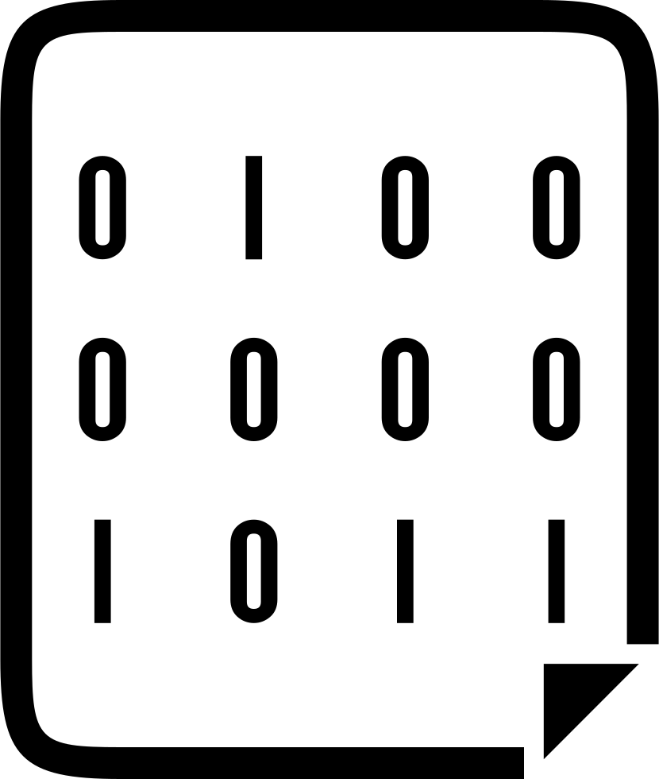
Machine Code - Binary
This is the only language that the machine understands and runs.
Ones and Zeros (Set/Unset || Lit / Unlit)
Processor and Operating-System oriented.
We won’t code in this. Barely used nowadays.

Slide 5
Assembly
Readable
Needs translation into machine code
Processor oriented
MOV ax, 5 MOV bx, 17 ADD ax, bx

Slide 6
Low-Level Programming Language
Machine Code and Assembly are the two main low-level programming languages.
They are known as “low-level” because they are very close to how different hardware elements of a computer communicate with each other.

Slide 7
High-Level Programming Language (HLPL)
High-level programming languages are a lot closer to the logic of human communication.
Easy to use
More flexible
Assembly:
MOV ax, 5 MOV bx, 17 ADD ax, bx
High-Level:
x = 17 + 5 >>> 22

Slide 8
How do these high-level languages run?
Compilation!
HLPL
Assembly
Machine Code

Slide 9
Compiled and Interpreted Languages
In compilation, the whole script (code file) is translated from readable language to machine code.
This machine code outputs a compiled file that is ready for execution. (for example: .exe) The program still has not been run!
You can run this compiled file repeatedly. In interpretation, each line is translated into machine code and executed, one line after the other.
For each rerun, each line must be translated again and again.

Slide 10
Python

Slide 11
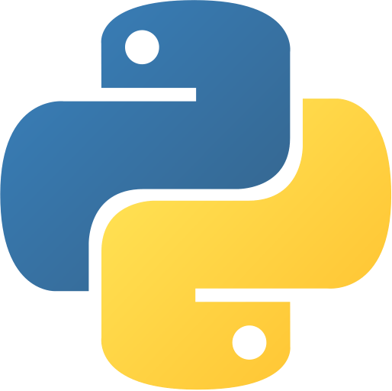
History of Python
Python 2.0 was first released in 2000. Its latest version, 2.7, was released in 2010.
Python 3.0 was released in 2008. Its latest version, 3.7, was released in 2018.
Since January 1, 2020, Python 2.7 has "retired" and no longer be maintained.

Slide 12
Why Python?
High level
Interpreted
Very readable and easy to use
Used a lot in the field of cyber security
A lot of tools, exploits and POCs are written in python

Slide 13
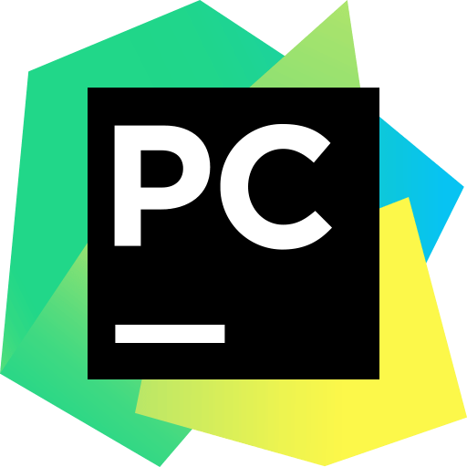
PyCharm Installation
Follow lab 5.1.1 to install PyCharm

Slide 14
Thank You!

